Slide 1
2nd and 3rd Century – Age of the Apologists and Heresiologists (150 to 250 AD)
Session 2

Slide 2
Key Events and Places

Slide 3
Key Events
First part of second century a Period of relative peace for the church.
Clement of Rome writes letter to Corinthian Church (end of 1st c.)
5 good emperors – Trajan, Hadrian,,Antoninus Pius, and two emperors who fit into the second half of 2nd century: Lucius Verus, Marcus Aurelius
Trajan (emp. 98-117) expands the empire (the last emperor really to expand the empire – the rest were more or less defending and improving what they had. Concerning his attitude towards Christians, see Pliny’s Letter to Trajan.
Hadrian (emp. 117-138) builds his walls in the Northern part of England (122-32) and later Antoninus Pius builds a wall across central Scotland
Antoninus Pius (emp. 138-161 – 22 years) presided over a largely peaceful empire. He initiated many public works projects, building and improving the network of Roman roads, Roman education and schools, aqueducts, etc. According to Miletus of Sardis, he ordered that Christians not be persecuted without a trial.

Slide 4
Pliny’s Letter to Trajan (112 AD)
It is my practice, my lord, to refer to you all matters concerning which I am in doubt. For who can better give guidance to my hesitation or inform my ignorance? I have never participated in trials of Christians. I therefore do not know what offenses it is the practice to punish or investigate, and to what extent. And I have been not a little hesitant as to whether there should be any distinction on account of age or no difference between the very young and the more mature; whether pardon is to be granted for repentance, or, if a man has once been a Christian, it does him no good to have ceased to be one; whether the name itself, even without offenses, or only the offenses associated with the name are to be punished.
Meanwhile, in the case of those who were denounced to me as Christians, I have observed the following procedure: I interrogated these as to whether they were Christians; those who confessed I interrogated a second and a third time, threatening them with punishment; those who persisted I ordered executed. For I had no doubt that, whatever the nature of their creed, stubbornness and inflexible obstinacy surely deserve to be punished. There were others possessed of the same folly; but because they were Roman citizens, I signed an order for them to be transferred to Rome.

Slide 5
Pliny’s Letter to Trajan
Soon accusations spread, as usually happens, because of the proceedings going on, and several incidents occurred. An anonymous document was published containing the names of many persons. Those who denied that they were or had been Christians, when they invoked the gods in words dictated by me, offered prayer with incense and wine to your image, which I had ordered to be brought for this purpose together with statues of the gods, and moreover cursed Christ--none of which those who are really Christians, it is said, can be forced to do--these I thought should be discharged. Others named by the informer declared that they were Christians, but then denied it, asserting that they had been but had ceased to be, some three years before, others many years, some as much as twenty-five years. They all worshipped your image and the statues of the gods, and cursed Christ.

Slide 6
Pliny’s Letter to Trajan
They asserted, however, that the sum and substance of their fault or error had been that they were accustomed to meet on a fixed day before dawn and sing responsively a hymn to Christ as to a god, and to bind themselves by oath, not to some crime, but not to commit fraud, theft, or adultery, not falsify their trust, nor to refuse to return a trust when called upon to do so. When this was over, it was their custom to depart and to assemble again to partake of food--but ordinary and innocent food. Even this, they affirmed, they had ceased to do after my edict by which, in accordance with your instructions, I had forbidden political associations. Accordingly, I judged it all the more necessary to find out what the truth was by torturing two female slaves who were called deaconesses. But I discovered nothing else but depraved, excessive superstition.

Slide 7
Pliny’s Letter to Trajan
I therefore postponed the investigation and hastened to consult you. For the matter seemed to me to warrant consulting you, especially because of the number involved. For many persons of every age, every rank, and also of both sexes are and will be endangered. For the contagion of this superstition has spread not only to the cities but also to the villages and farms. But it seems possible to check and cure it. It is certainly quite clear that the temples, which had been almost deserted, have begun to be frequented, that the established religious rites, long neglected, are being resumed, and that from everywhere sacrificial animals are coming, for which until now very few purchasers could be found. Hence it is easy to imagine what a multitude of people can be reformed if an opportunity for repentance is afforded.

Slide 8
Trajan’s Response
You observed proper procedure, my dear Pliny, in sifting the cases of those who had been denounced to you as Christians. For it is not possible to lay down any general rule to serve as a kind of fixed standard. They are not to be sought out; if they are denounced and proved guilty, they are to be punished, with this reservation, that whoever denies that he is a Christian and really proves it--that is, by worshiping our gods--even though he was under suspicion in the past, shall obtain pardon through repentance. But anonymously posted accusations ought to have no place in any prosecution. For this is both a dangerous kind of precedent and out of keeping with the spirit of our age.

Slide 9
Trajan’s Response
Christians should not be sought out for trial.
Christians must be punished if, after being accused, they are found guilty of being Christian (the nomen was enough to convict)
If the accused deny they are Christians and show proof that they are not Christians by worshipping the gods, then they must be pardoned (note – it is not emperor worship but civil religion of which they are accused of violating).
Anonymous accusations are not to be entertained.

Slide 10
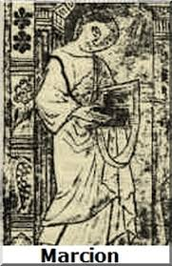
Other Key Events
Bar Kokhba revolt of 132-135 is the final straw for Rome in dealing with the Jews
Hadrian defeats the revolt and removes the Jews from Jerusalem and turns Jerusalem into a pagan city named after himself (his full name) Aelia Capitolina.
Christians maintain a presence in Jerusalem but the city is much diminished. Hadrian places pagan temples over the Christian sites (which ironically helps Helena, the mother of Constantine, locate the holy sites in the 4th century where churches are then built)
Marcion of Sinope becomes popular in Rome. Excommunicated in 144.
Polycarp Martyred (155 AD)

Slide 11
Key Places
Jerusalem – but not for long
Rome (Clement of Rome’s Epistles)
Alexandria and North African Christianity (Epistle of Barnabas, Didache)
Asia Minor (Letters of Ignatius of Antioch)

Slide 12
Key Events
165-180 The Antonine Plague in Rome, aka Plague of Galen
177-180 – Local Persecutions ensue during the reign of Marcus Aurelius who, at least initially, was friendly towards the Christians, but not so much later in his reign.
Persecutions in Lyon and Vienna (Vindobona) (177)
Alexandria
Scili (180)
After the death of Marcus Aurelius which ends what we know as the Pax Romana you have Commodus – think of the movie Gladiator

Slide 13
Key Events
192 Commodus assassinated
5 emperors in rapid succession culminating in Severus (not Snape)
What does this tell us about the Roman Empire at this time?
Septimius Severus – sole emperor 197-211, new dynasty
He was originally from Africa, as was the Pope at the time of his rule – Pope Victor
Forbids conversions to Christianity
235 one of the Severian emperors (Severus Alexander) is assassinated.

Slide 14
Key Events
Ushers in a period of chaos and uncertainty, with civil wars, political upheaval, economic unrest, and invasions from the barbarians.
The empire is effectively split into East and West and is thrown into turmoil for the next 50 years.
The Christians again become an easy scapegoat, although Christianity continues to grow and even begins building churches
African Church especially vibrant. Egyptian church has over 1 million members; Carthage and Alexandria dominant theologically and spiritually.
248 – 1000th anniversary of founding of Rome

Slide 15
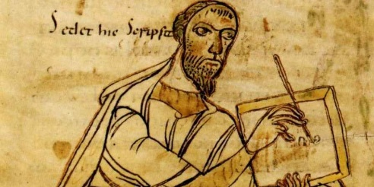
Key Events
Celsus writes On the True Doctrine (ca. 178 AD)
Origen responds almost 70 years later with Contra Celsum (ca. 248)
Porphyry writes Against the Christians (ca. 280 AD)_

Slide 16
Key People

Slide 17
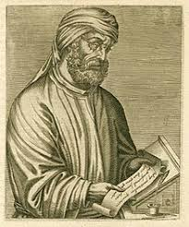
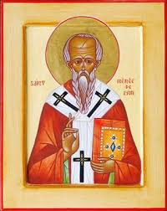
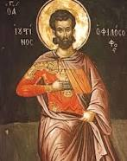
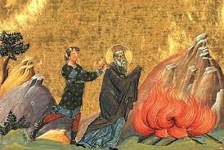
Key People and Places
Apostolic Fathers
Justin Martyr (Rome)
Pope Victor (189-99)
Irenaeus of Lyon
Tertullian of Carthage
Dionysius of Alexandria
Dionysius of Rome
Hippolytus of Rome
Clement of Alexandria
Origen (Alexandria, then Caesarea)

Slide 18
Justin Martyr (Rome 100-165 AD)
Born in Flavia Neapolis, in Samaria, c. 114AD
Family of Roman origin, and likely wealthy
Travelled much, spreading the gospel
Settled in Rome as a Christian teacher
Lived in the reign of Antoninus Pius
Martyred in the reign of Marcus Aurelius, 165AD

Slide 19
Justin Martyr (Rome 100-165 AD)
Wandered around looking for a teacher – found an old man by the sea
Became a defender of the Faith
Works:
Apology I and II
Dialog with Trypho the Jew
Teacher of Tatian

Slide 20
Justin and the Sacraments (Baptism) – Apology 61
We learned from the apostles this reason for this [rite]. At our first birth we were born of necessity without our knowledge, from moist seed, by the intercourse of our parents with each other, and grew up in bad habits and wicked behavior. So that we should not remain children of necessity and ignorance, but [become sons] of free choice and knowledge, and obtain remission of the sins we have already committed, there is named at the water, over him who has chosen to be born again and has repented of his sinful acts, the name of God the Father and Master of all. Those who lead to the washing the one who is to be washed call on [God by] this term only. For no one may give a proper name to the ineffable God, and if anyone should dare to say that there is one, he is hopelessly insane. This washing is called illumination, since those who learn these things are illumined within. The illuminand is also washed in the name of Jesus Christ, who was crucified under Pontius Pilate, and in the name of the Holy Spirit, who through the prophets foretold everything about Jesus. Apology 61

Slide 21
Justin and the Sacraments (Eucharist) – Apology 65
65. We, however, after thus washing the one who has been convinced and signified his assent, lead him to those who are called brethren, where they are assembled. They then earnestly offer common prayers for themselves and the one who has been illuminated and all others everywhere, that we may be made worthy, having learned the truth, to be found in deed good citizens and keepers of what is commanded, so that we may be saved with eternal salvation. On finishing the prayers we greet each other with a kiss. Then bread and a cup of water and mixed wine are brought to the president of the brethren and he, taking them, sends up praise and glory to the Father of the universe through the name of the Son and of the Holy Spirit, and offers thanksgiving at some length that we have been deemed worthy to receive these things from him. When he has finished the prayers and the thanksgiving, the whole congregation present assents, saying, "Amen." "Amen" in the Hebrew language means, "So be it."

Slide 22
Justin and the Sacraments (Eucharist)
When the president has given thanks and the whole congregation has assented, those whom we call deacons give to each of those present a portion of the consecrated bread and wine and water, and they take it to the absent. 66. This food we call Eucharist, of which no one is allowed to partake except one who believes that the things we teach are true, and has received the washing for forgiveness of sins and for rebirth, and who lives as Christ handed down to us. For we do not receive these things as common bread or common drink; but as Jesus Christ our Saviour being incarnate by God's word took flesh and blood for our salvation, so also we have been taught that the food consecrated by the word of prayer which comes from him, from which our flesh and blood are nourished by transformation, is the flesh and blood of that incarnate Jesus. Apology 65-66

Slide 23
Justin on Worship – Apology 67
And on the day called Sunday there is a meeting in one place of those who live in cities or the country, and the memoirs of the apostles or the writings of the prophets are read as long as time permits. When the reader has finished, the president in a discourse urges and invites [us] to the imitation of these noble things. Then we all stand up together and offer prayers. And, as said before, when we have finished the prayer, bread is brought, and wine and water, and the president similarly sends up prayers and thanksgivings to the best of his ability, and the congregation assents, saying the Amen; the distribution, and reception of the consecrated [elements] by each one, takes place and they are sent to the absent by the deacons.

Slide 24
Justin on Worship – Apology 67
Those who prosper, and who so wish, contribute, each one as much as he chooses to. What is collected is deposited with the president, and he takes care of orphans and widows, and those who are in want on account of sickness or any other cause, and those who are in bonds, and the strangers who are sojourners among [us], and, briefly, he is the protector of all those in need. We all hold this common gathering on Sunday, since it is the first day, on which God transforming darkness and matter made the universe, and Jesus Christ our Saviour rose from the dead on the same day. For they crucified him on the day before Saturday, and on the day after Saturday, he appeared to his apostles and disciples and taught them these things which I have passed on to you also for your serious consideration. Apology 67

Slide 25
Irenaeus of Lyon (Lugdunum/Gaul/France) 130-202
Made bishop of Lyon after former bishop martyred in 177
Major works:
Adversus Haereses (Against Knowledge “so called”) in 5 Books
On the Apostolic Preaching
Wrote against Gnosticism
Only Four Gospels
Theology of Recapitulation (anakephalaiosis)

Slide 26
Tertullian of Carthage (160-220)
Lawyer or presbyter or both
Worked out much of the Latin language of theology
Trinitarian language set pattern in the West. Una substantia, tres personae.
Legal terminology and penance
Wrote:
Apologia
Contra Marcionem
Ad Praxeas

Slide 27
Tertullian of Carthage (160-220)
Converted to Montanism around 208.
Saw church getting corrupt and lacking in spirituality
Wrote many ascetical treatises
The Veiling of Virgins
De Corona
De Spectaculis
De Ekstasis (not extant)

Slide 28
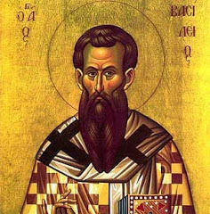
Clement of Alexandria (ca. 150-215)
Theologian/Philosopher
Born in Athens or Alexandria
Converted later in life after searching for the most renowned teacher
Discovered teaching of Pantaenus, a teacher at the Alexandrian School of Theology
After conversion, he later succeeded Pantaenus
Offered a “new philosophy,” distinct from the prominent philosophical schools in Alexandria in that it was informed not only by the philosophy and culture prominent at that time, but by the Christian ideal of how to live—

Slide 29
Clement of Alexandria (ca. 150-215)
Forced to flee Alexandria due to persecution from the emperor Septimius Severus which began around 202/203. He fled the city, as did many others, and ended up in Cappadocia where he took refuge with his friend Bishop Alexander
His teaching penetrated ranks of the Wealthy
Wrote about the true Gnosticism
Writings
Whether the Rich Man Too Can Be Saved
Protrepticus (Exhortation to the Greeks)
Paedagogus (The Instructor)
Stromata (Miscellanies)
The goal of Clement’s interpretation of Scripture was to discover the deeper, spiritual sense of Scripture which would enable a true knowledge, or Gnosis, of God

Slide 30
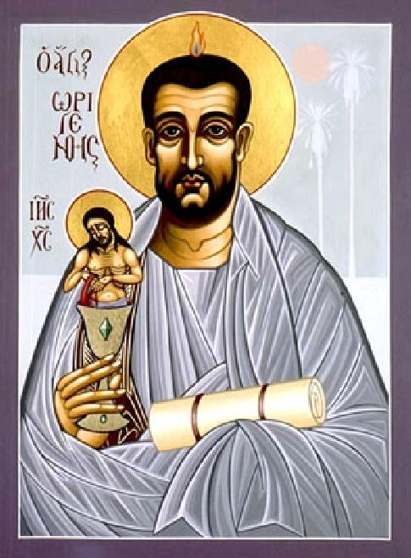
Origen of Alexandria (184-254)
Teacher and Interpreter of the Bible
Origen and his father Leonides – and how his mother saved him
Extremely devout – took Mt. 5:30 literally – some brought this up to say he was disqualified from priesthood
Started teaching at age 18
Accumulated a library
Didn’t get along with his Bishop
Moved from Alexandria to Caesarea
Wrote at least 2000 (maybe up to 6000) works

Slide 31
Origen of Alexandria (184-254)
Most of his work destroyed at 5th ecumenical Council – due to Origenist Controversy (Epiphanius, Jerome, Rufinus, Evagrius)
Condemned for his speculations on the pre-existence of souls and his teaching of apokatastasis, et. al.
Chief Works – Commentaries and Homilies, On First Principles, Contra Celsum, On Prayer
First Real Textual Critic – Hexapla
Imprisoned as an old man during Decian persecution, didn’t die in jail (some accused of giving in) but died of wounds a few years later

Slide 32
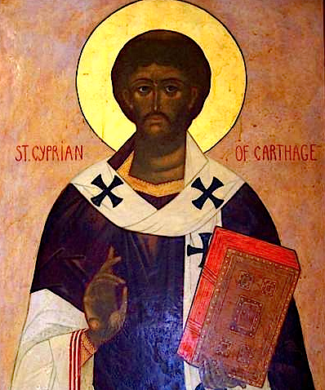
Cyprian of Carthage (ca. 210-258)
Bishop and Martyr
Convert late in life – was a former government official and wealthy patron
Bishop from 249-258
Wrote 12 treatises
On the Lord’s Prayer, On the Unity of the Catholic Church, On Almsgiving, On the Plague, On the Lapsed, On Mortality, On Jealousy and Envy, On Patience, Exhortation to Martyrdom, Testimonies Against the Jews etc.
Provided a defense of his fleeing for the first time he was arrested.
Martyred as a Roman citizen. How?

Slide 33
Cyprian of Carthage (ca. 210-258)
Faced with the task of dealing with the restoration of three types of people who had experienced the persecutions:
those who had flocked to the pagan temples in order to comply with the demands of the emperor, as well as
(2) those who had bowed to pressure from relatives and friends and
(3) those who had obtained false certificates in order to avoid persecution. Alongside those who had escaped persecution stood the “Confessors,”

Slide 34
Cyprian of Carthage (ca. 210-258)
A synod was called to resolve the issue, for which Cyprian wrote two treatises: On the Unity of the Church and On the Lapsed. The resolution to the conflict Cyprian offered in these documents was that those who refused to do penance should not be forgiven, even on their deathbeds; those who purchased certificates should be admitted into the Church immediately; the fallen should do penance for the rest of their lives and be restored on their deathbed, or, if they remained faithful during another persecution they should be reinstated. He further counseled that fallen clergy should be deposed and schismatics (i.e., those who separated themselves from the life of the church) excommunicated.
He and the Councils at Carthage also prescribed various forms of penance.
Martyred Sept. 14, 258

Slide 35
Key Issues

Slide 36
Key Issues
Fake News and Disinformation about Christians (Celsus/Porphyry)
Enter the Apologists
Plague and Sickness
Immorality and rot from within
Fixing the date of Easter still in flux – Quartodeciman Controversy
Montanism still around

Slide 37
More False Teachings to Contend With
Marcian
Basilides, Valentinus, and other Gnostics
- Doctrinal Formulations Beginning
- Tertullian’s Trinitarian terminology becomes the standard for Western/Latin Christianity (una substantia, tres personae)
- Tension over what documents are authoritative in the life of the church because of Marcian.
- First Commentaries on the Bible are being written (Heracleon and Origen)
- More thoroughgoing doctrinal treatises being written.
- Irenaeus – Against Heresies
- Origen – On First Principles, Contra Celsus
- Tertullian – Against Marcian, Apology – many ascetical treatises

Slide 38
Church Becoming Stronger
Despite persecution which is localized
Tertullian talks about Christians being almost more numerous than the pagans in Carthage.
Bishops becoming more important and central to life of the church
They perform Baptisms on Easter Vigil
Attend councils and decide doctrine
Presbyters become more closely associated with Eucharist
Deacons gaining in authority and power (only 7 in any one city)
Church councils being called to deal with issues regionally, esp. in Carthage, North Africa
Church buildings start being built – ex. of Dura Europa where there was also a synagogue

Slide 39
Church Becoming Stronger
Eusebius tells us that even some emperors seem sympathetic to Christianity. In fact, some of the emperors that ended up persecuting the church were initially favorably disposed to the church, like Gallienus (who came after Decius, see Eusebius, p. 238) and Licinius (early 4th c) who co-ruled for a while with Constantine.
Peter Brown points out that Christianity was already becoming a force to be reckoned with before Constantine arrives on the scene. In Rome in the early third century, he writes, “the Church included a powerful freedman chamberlain of the emperor; its bishop was a former slave of that freedman; it was protected by the emperor’s mistress, and patronized by noble ladies.”
Vast network of travel and communication among the bishops and congregations
Christians stood out for their care of the poor and the sick – especially during times of plague

Slide 40
Scilli Marytrdom Account
The Acts of the Scillitan Martyrs
1. [Latin] During the consulship of Praesens (second term) and Condianus, on 17 July, in Carthage, there were led into the governor’s office: Speratus, Nartzalus and Cittinus; Donata, Secunda, Vestia. Saturninus the governor said: “You can have mercy from our lord the emperor, if you return to your senses.”
2. [Latin] Speratus said: “We have never done wrong. We have stayed clear of treating people unfairly. We have never spoken ill of anyone. Instead, when treated badly, we have offered thanks, because we obey our own ruler.”
3. [Latin] Saturninus the governor said: “We too are religious and our religion is simple: we swear by the birth spirit of our lord the emperor and offer sacrifice for his health, which you must do as well.”

Slide 41
4. [Latin] Speratus said: “If you are prepared to listen to me, I will tell you a mystery of simplicity.”
5. [Latin] Saturninus said: “If you’re going to tell bad things about our sacred rituals, I will not listen to you. Rather, swear by the birth spirit of our lord the emperor.”
6. [Latin] Speratus said: “I do not acknowledge the authority of this world, but I rather serve that God whom no one has seen or can see with these eyes. I have never been guilty of theft, but whenever I buy, I pay the tax, because I acknowledge my lord, the king of kings and ruler of all peoples.”

Slide 42
7. [Latin] Saturninus the governor said to the others: “Stop being of this persuasion!”
Speratus said: “The persuasion to commit murder and to bear false testimony is a worse persuasion.”
8. [Latin] Saturninus the governor said: “Stop being part of this madness!”
Cittinus said: “We have no other to fear but the Lord our God, who is in heaven.”

Slide 43
9. [Latin] Donata said: “Honor to Caesar in his capacity as Caesar, but fear to God.”
Vestia said: “I am a Christian.”
Secunda said: “What I am is exactly what I want to be.”
10. [Latin] Saturninus the governor said to Speratus: “Do you persevere in being a Christian?”
Speratus said: “I am a Christian”, and all uttered their agreement with him.

Slide 44
11. [Latin] Saturninus the governor said: “Do you want some time to consider the matter carefully?”
Speratus said: “In such a just cause there is no need for careful consideration.”
12. [Latin] Saturninus the governor said: “What sort of things do you have in that case of yours?”
Speratus said: “Books and letters of Paul, a righteous man.”
13. [Latin] Saturninus the governor said: “Have a delay of 30 days and think things over!”
Again Speratus said: “I am a Christian”, and all uttered their agreement with him.

Slide 45
14. [Latin] Saturninus the governor read aloud the sentence from a tablet: “Concerning Speratus, Nartzalus, Cittinus, Donata, Vestia, Secunda and the others who have confessed that they live according to the Christian religion: because inspite of the opportunity given to them to return to the Roman way of life, they have stubbornly persisted in maintaining theirs, I have decided that they be put to the sword.”
15. [Latin] Speratus said: “We offer thanks to God.”
Nartzalus said: “Today we are martyrs in heaven. Thanks to God.”

Slide 46
16. [Latin] Saturninus the governor ordered a herald to declare his sentence: “I have ordered Speratus, Nartzalus, Cittinus, Veturius, Felix, Aquilinus, Laetantius, Januaria, Generosa, Vestia, Donata and Secunda, to be execu
17. [Latin] All said: “Thanks to God.”
And immediately they were decapitated for the name of Christ.
Amen.ted.”

Slide 47
Review and Lesson for the Church for Today

